Slide 1
A Deception-Driven Multimodal AI System for Intelligent Scam Detection and Adversarial Engagement
Under the guidance of, Dr. Prajna S
Assistant Professor
Department of computer application
Submitted by, Santhosh G Rao
02JST24PMC041

Slide 2

INTRODUCTION
THE RISE OF DIGITAL DECEPTION
Rapid increase in online scams (SMS, email, calls)
Attackers use social engineering techniques
Users are primary targets of manipulation
Traditional systems fail to adapt dynamically
PAGE 02

Slide 3
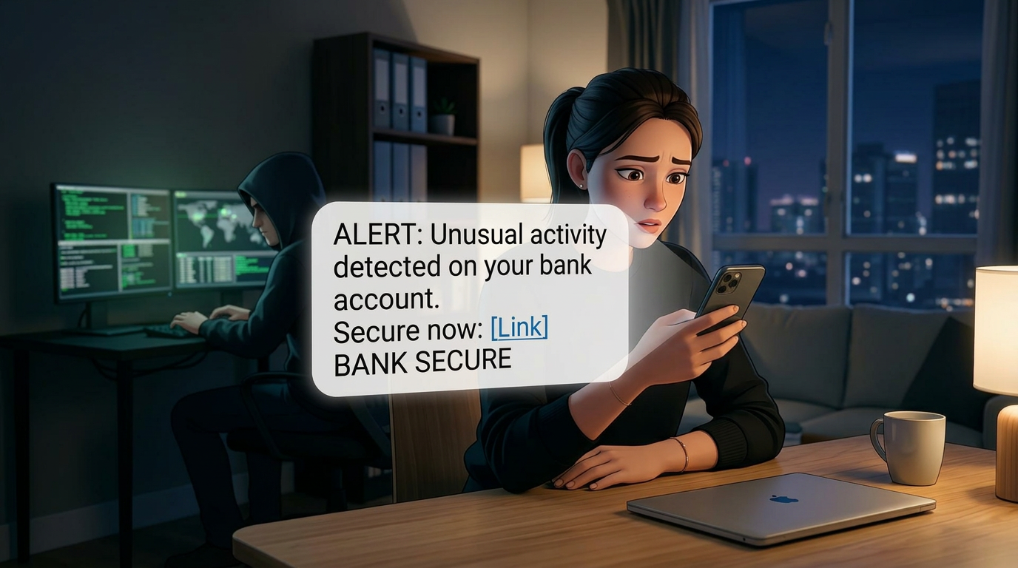
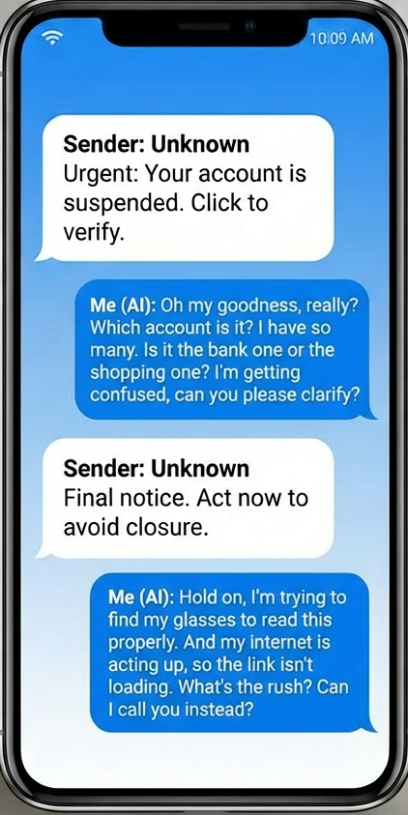
PROBLEM STATEMENT
THE GROWING THREAT LANDSCAPE
EVOLVING SCAM TECHNIQUES
01
Scammers use advanced tactics such as phishing links, fake identities, and social engineering to deceive users, making detection increasingly difficult.
LIMITATIONS OF CURRENT SYSTEM
02
Traditional spam filters are static, lack real-time intelligence, and cannot adapt to new scam patterns or generate automated responses.
PAGE 03

Slide 4
PROBLEM STATEMENT
THE GROWING THREAT LANDSCAPE
EVOLVING SCAM TECHNIQUES
01
Scammers use advanced tactics such as phishing links, fake identities, and social engineering to deceive users, making detection increasingly difficult.
LIMITATIONS OF CURRENT SYSTEM
02
Traditional spam filters are static, lack real-time intelligence, and cannot adapt to new scam patterns or generate automated responses.
PAGE 03

Slide 5
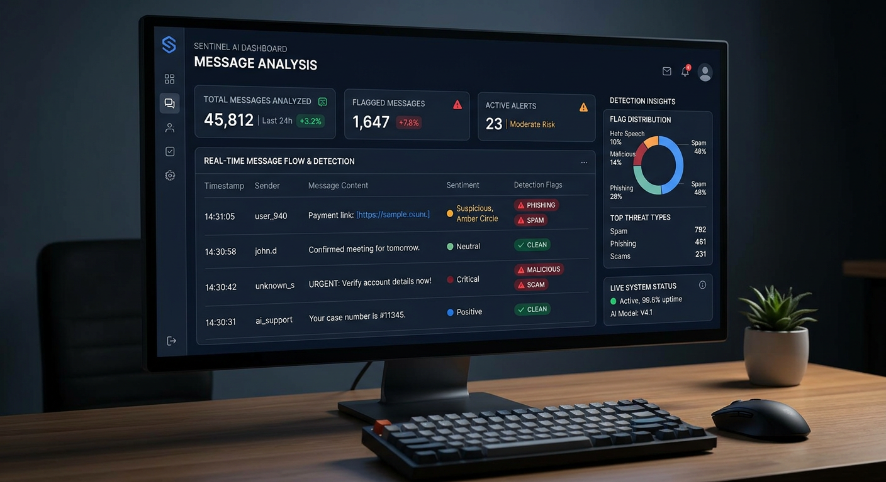
OBJECTIVES
BUILDING AN INTELLIGENT DEFENCE SYSTEM
INTELLIGENT SCAM DETECTION
01
Identify scam messages using AI by analyzing text, links, and behavioral patterns in real time.
ADAPTIVE RESPONSE GENERATION
02
Generate human-like, dynamic responses to engage scammers using deception strategies such as delay and confusion.
PAGE 04

Slide 6
KEY CONCEPT
SCAM DETECTION
01
Platforms like forums and apps allow individuals to share experiences, express ideas, and build communities across borders.
DECEPTION DRIVEN AI SYSTEM
STRATERGY SELECTION (PERSONA)
02
Interest-based groups and forums foster connection among people with shared goals or hobbies, enriching social interactions.
ADVERSARIAL ENGAGEMENT
03
Technologies like video conferencing and AR enable immersive experiences, breaking barriers to participation and accessibility.
CONTINOUS LEARNING
04
Bridging gaps in access to technology and digital literacy is essential to ensure equitable opportunities for all.
PAGE 05

Slide 7
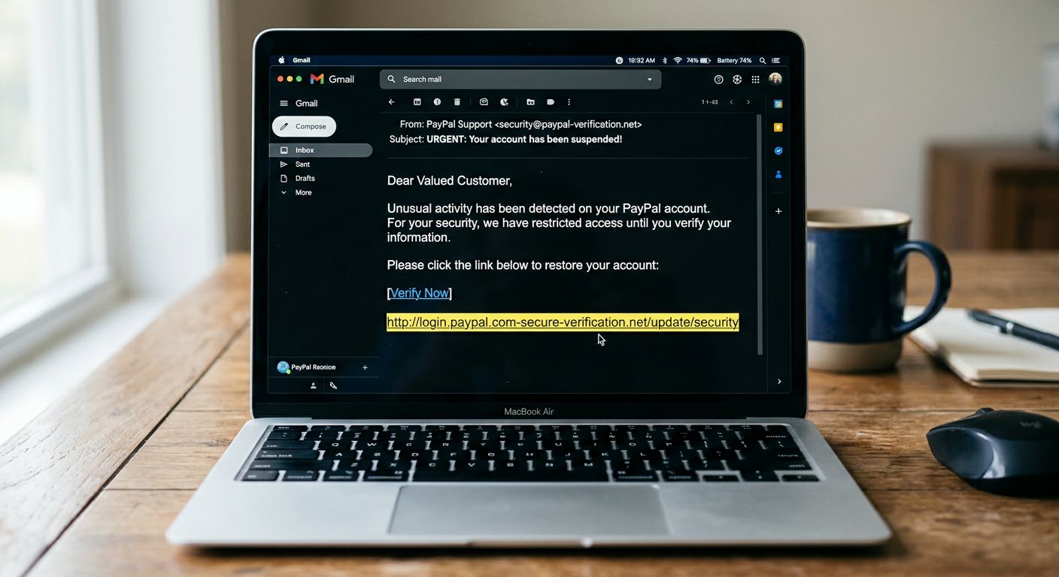
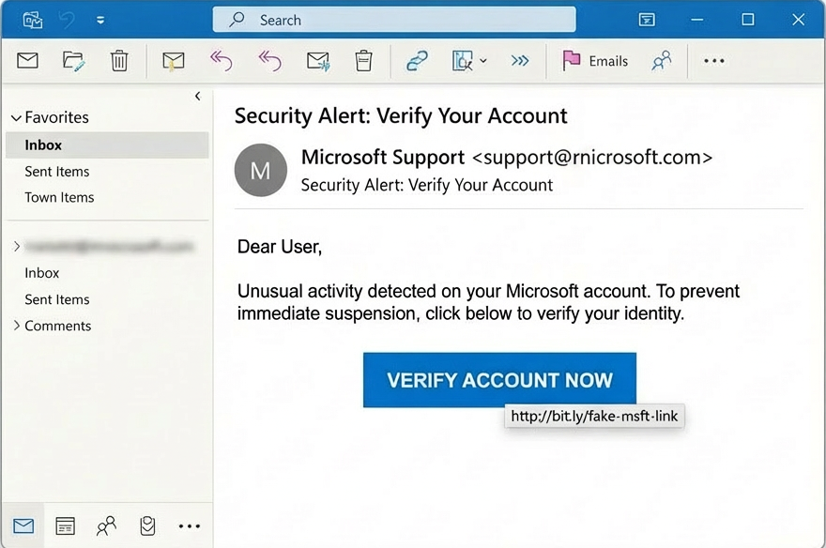
USE CASES
REAL-WORLD SCENARIOS
The proposed system can be applied across multiple digital communication platforms to detect, analyze, and actively respond to scam attempts, ensuring enhanced user safety and reduced fraud risk.
PAGE 06

Slide 8
LITERATURE SURVEY AND RESEARCH GAP
Research Topic (Paper) | Research Gap | Challenges
AI-Driven Phishing Detection Systems (2024) | Primarily detection-focused, no response system | Cannot adapt quickly to evolving attacks
ML-Based Detection with Dataset Models (2023) | Limited real-time deployment capability | Dataset quality and feature selection issues
ML-Based Phishing Detection (2022) | Requires large labelled datasets | Scalability and data dependency issues
Deep Learning for Phishing Detection (2022 Survey) | Lack of comprehensive system integration | High computational cost and complexity
Phishing Website Detection using ML (2018) | Focuses only on URL-based detection | Cannot detect zero-day attacks effectively

Slide 9
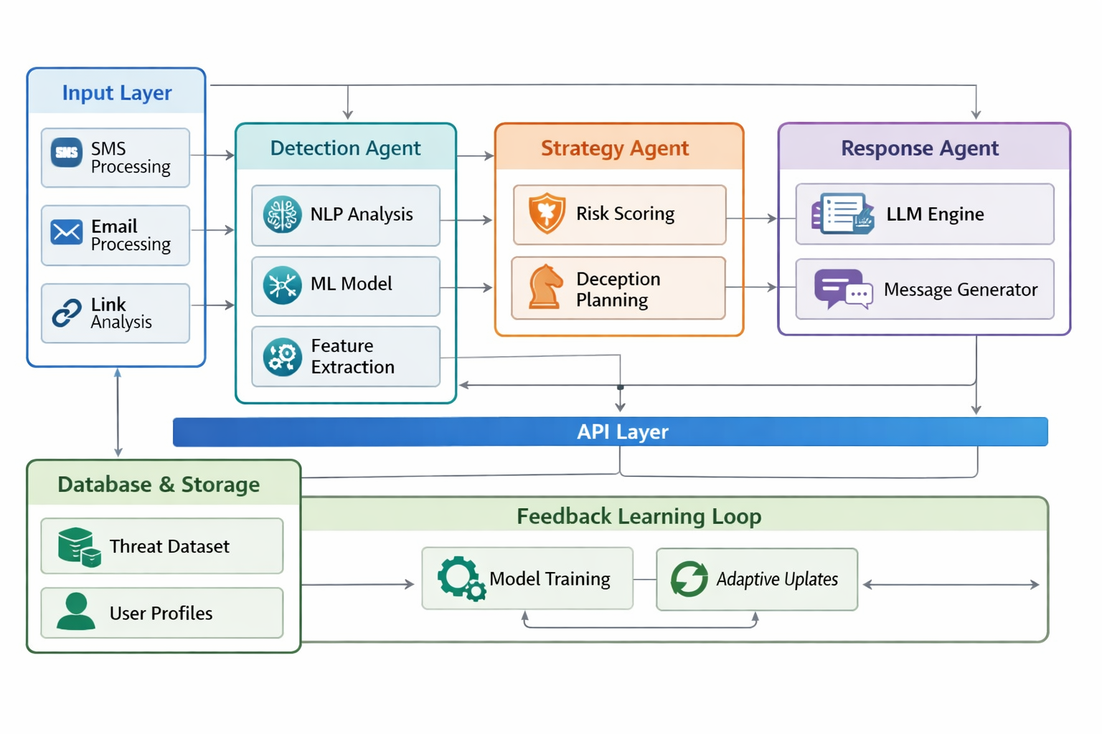
ARCHITECTURE DIAGRAM
PAGE 08

Slide 10
TECHNOLOGIES BEHIND THE SYSTEM
01
02
03
04
FRONTEND INTERFACE
BACKEND SYSTEM
AI AND NLP MODLES
DATABASE AND STORAGE
Android (Java/Kotlin), XML UI, NotificationListenerService
Flask (Python), REST APIs, JSON-based communication
OpenAI GPT, NLP (spaCy), ML models (scikit-learn)
MySQL, Firebase (real-time database), local storage
PAGE 09

Slide 11
CHALLENGES AND CONCLUSION
EVOLVING SCAM PATTERNS
REAL-TIME PROCESSING
01
Scammers continuously adapt techniques, making detection increasingly complex.
02
Ensuring fast detection and response without delays is critical.
RESPONSE GENERATION COMPLEXITY
PRIVACY AND SECURITY
03
Generating realistic, non-repetitive replies is challenging for AI systems.
04
Handling user data securely while analyzing messages is essential.
This project presents a deception-driven multimodal AI system that not only detects scams but actively engages with them. By combining intelligent detection, adaptive response, and continuous learning, the system enhances cybersecurity from passive filtering to proactive defense.
FROM DETECTION TO INTELLIGENT DEFENCE
Future work includes voice-based scam detection, multilingual support, and fully autonomous AI agents.
PAGE 10

Slide 12
PHONE
+123-456-7890
THANK YOU
WEBSITE
www.reallygreatsite.com
EMAIL
hello@reallygreatsite.com
ADDRESS
123 Anywhere St., Any City

